Slide 1
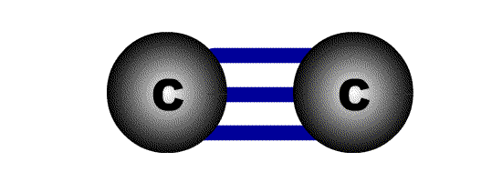
Infra red Spectroscopy
Part-III
INDRANIL CHAKRABORTY

Slide 2
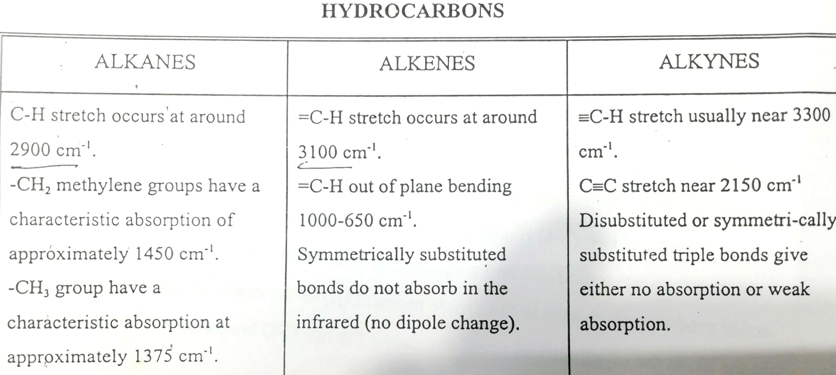

Slide 3
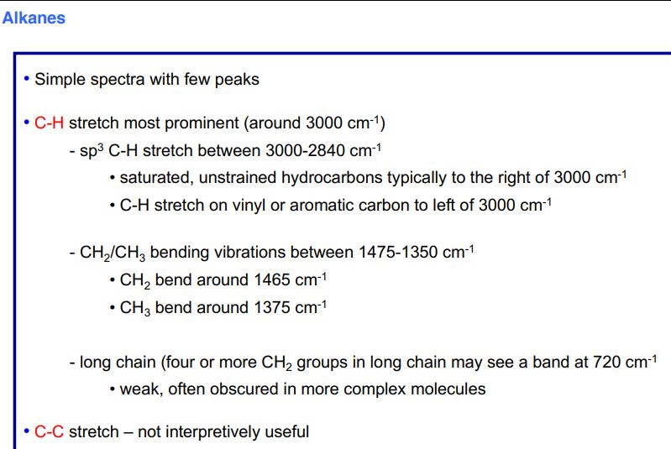

Slide 4
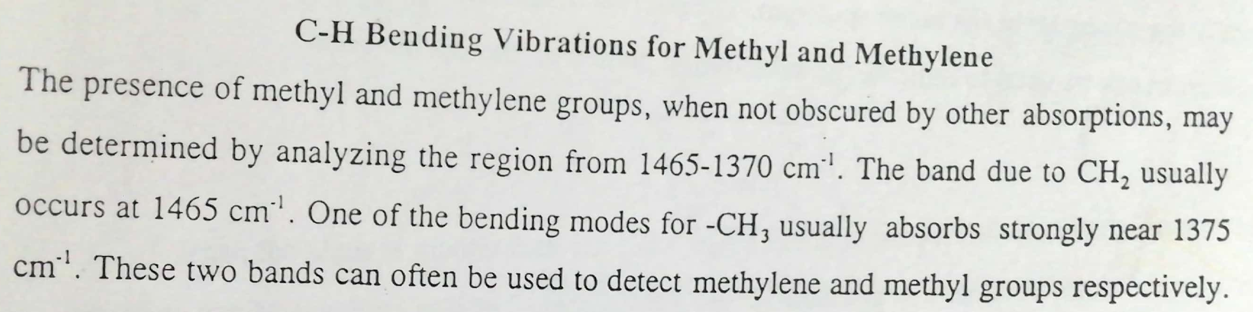
Whenever two methyl groups are present in geminal position, the signal at 1375 cm ⁻¹ is further split into two signals of almost equal intensities. This is due to in phase and out of phase C-H bending

Slide 5
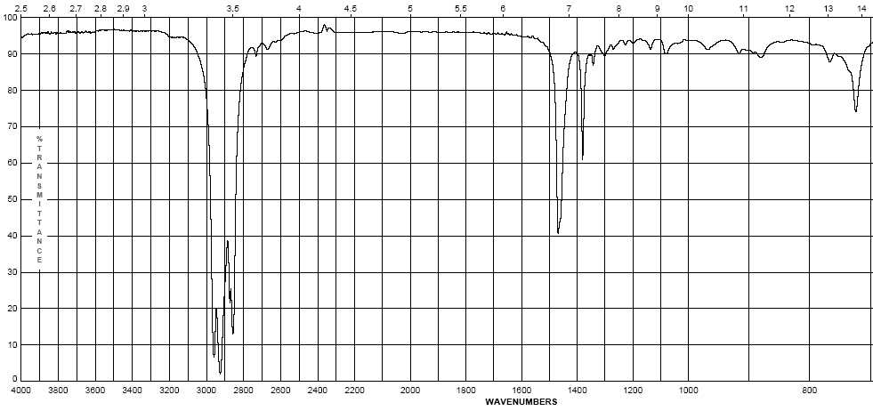
Octane
  Alkanes – combination of C-C and C-H bonds
    C-H bends 1370-1465 cm⁻¹
    CH₂-CH₂ bond 1450-1465 cm⁻¹
    CH₂-CH₃ bond 1370-1390 cm⁻¹
    sp³ C-H stretch between 2800-3000 cm⁻¹
(w – s)
(m)

Slide 6
Example of infrared spectrum
Transmittance (%)
100
Hexane
no peaks higher than 3000 cm⁻¹
0
4400 3600 2800 2000 1600 1200 800
Wave number, cm⁻¹
Notes:
6

Slide 7
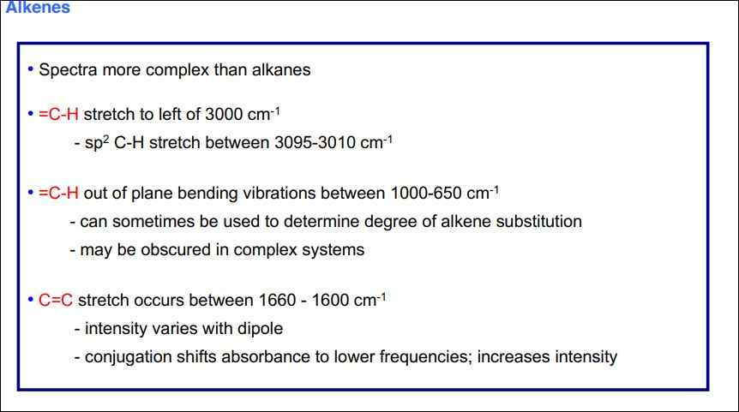

Slide 8
Infrared spectrum of 1-hexene
Transmittance (%)
100
C=C—H
C=C
CH₂=C—
peak higher than 3000 cm⁻¹
0
4400 3600 2800 2000 1600 1200 800
Wave number, cm⁻¹
Notes:
7

Slide 9
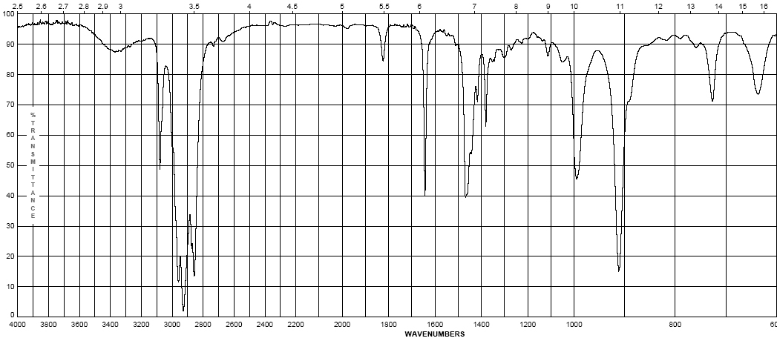
  Alkenes – addition of the C=C and vinyl C-H bonds
    C=C stretch at 1620-1680 cm⁻¹ : weaker as substitution increases ( change in dipole moment decreases as substitution increases)
    vinyl C-H stretch occurs at 3000-3100 cm⁻¹
    The difference between alkane, alkene or alkyne C-H is important ! If the band is slightly above 3000 it is vinyl sp² C-H or alkynyl sp C-H . If it is below it is alkyl sp³ C-H
1-Octene
(w – m)
(w – m)

Slide 10
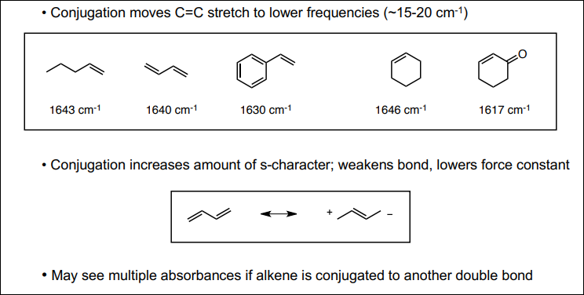
C=C Stretching
A. Effect of Conjugation
Intensity of absorption of C=C bond is generally much lower (than C=O). Symmetrically substituted double bonds do not absorb. Cis alkenes absorb more strongly than trans due to symmetry reason.
Conjugation of C=C carbonyl or other double bonds decrease bond order (i.e low force constant, k). Hence absorb at low frequency.

Slide 11
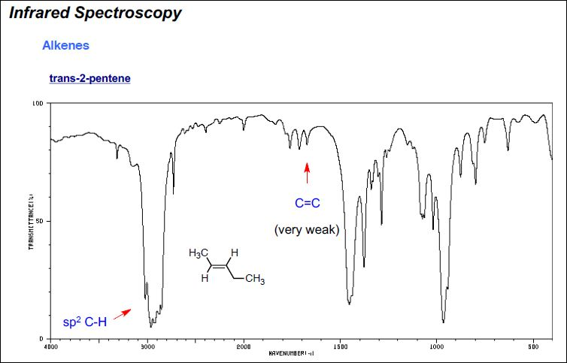
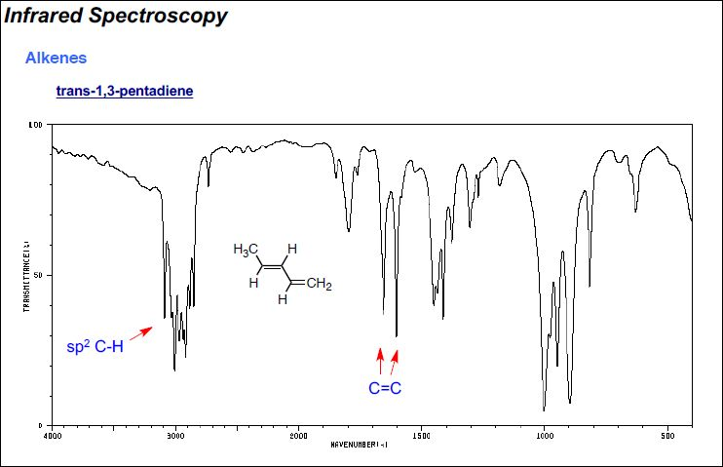

Slide 12
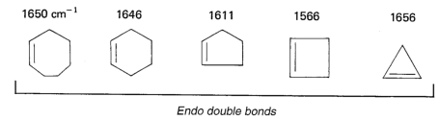
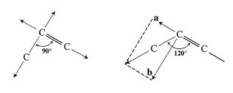
B. Ring size
1. Endocyclic double bond:
Absorption frequency in cyclic compounds are very sensitive to ring size, and decreases with decreasing internal bond angle until it reaches minimum at 90°, and again increases when bond angle further drops to 60°. This is because the C=C stretch in rings is strongly coupled to the neighbouring C-C stretch, which happens more as their vectors are in line.
As the angle approaches 90 degrees, the vector sum approaches 0, hence the degree of coupling approaches 0 and frequency approaches a minimum. Below 90 degrees, the coupling can once again take place.

Slide 13
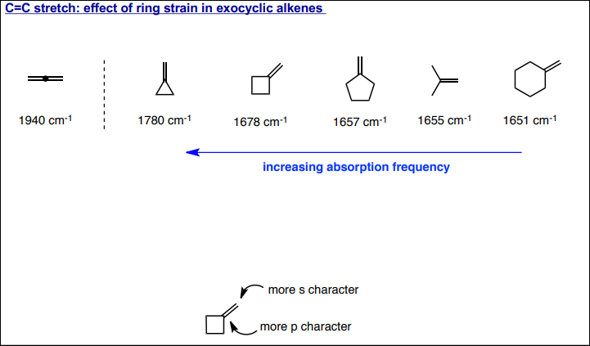
2. Exocyclic double bonds
Increase in Absorption frequency with decreasing ring size. Decreasing size increases p character in the inner bonds due to angle requirement. Thus s character of outer bond(= bond) increases and bond becomes strong.

Slide 14
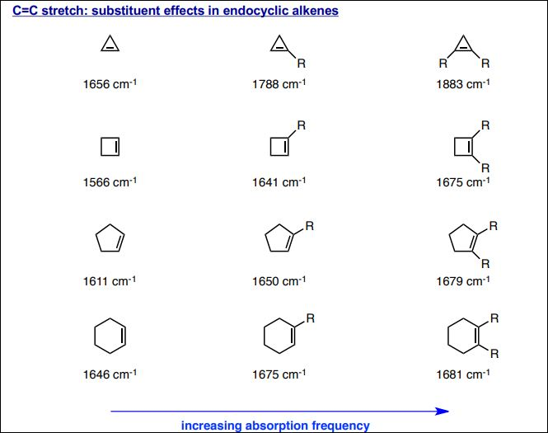

Slide 15
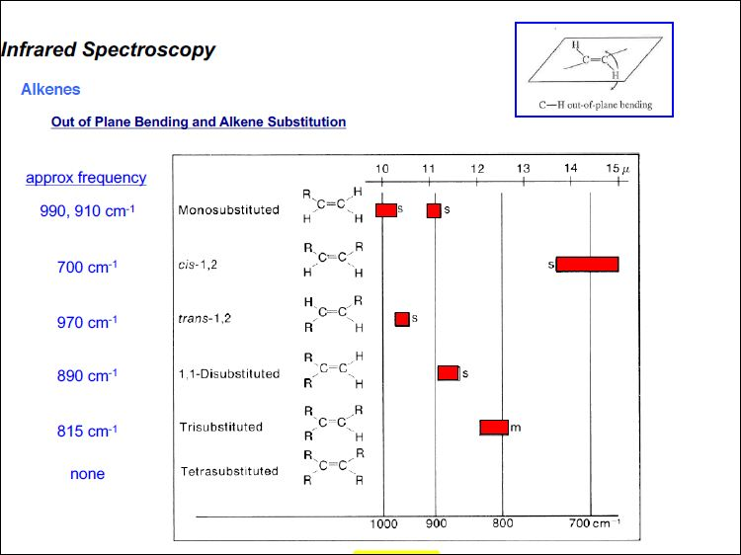

Slide 16
Alkynes
• ≡C-H stretch usually near 3300 cm⁻¹
sp C-H stretch between 3260-3390 cm⁻¹
• C≡C stretch vibrations between 2100-2250 cm⁻¹
- conjugation shifts absorbance to lower frequencies;
- absorbances for symmetrically substituted alkynes may be weak or absent

Slide 17
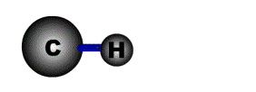
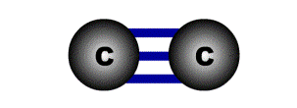
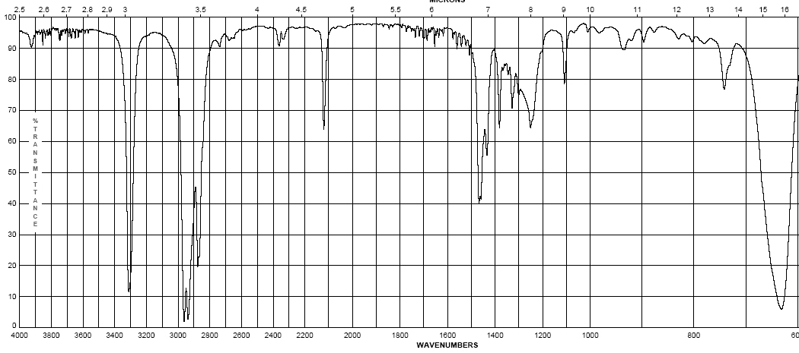
1-Octyne
  Alkynes – addition of the C=C and vinyl C-H bonds
    C≡C stretch 2100-2260 cm⁻¹; strength depends on asymmetry of bond, strongest for terminal alkynes, weakest for symmetrical internal alkynes
    C-H for terminal alkynes occurs at 3200-3300 cm⁻¹
    Internal alkynes ( R-C≡C-R ) would not have this band!
(w-m)
(m – s)

Slide 18
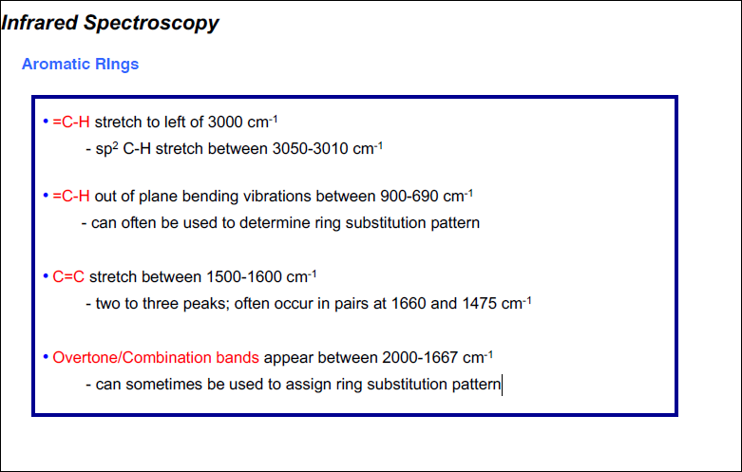

Slide 19
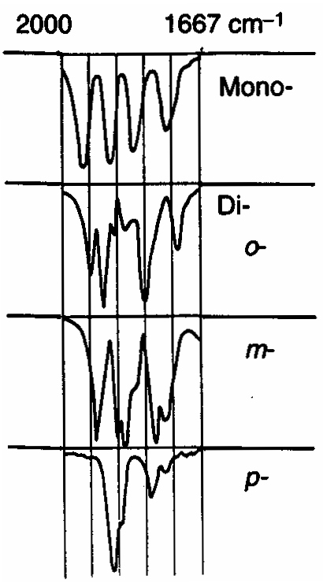
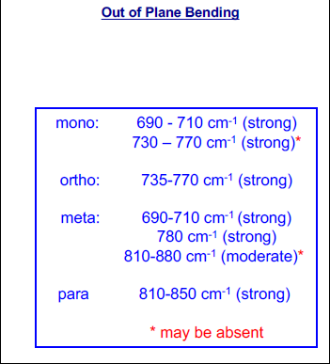
    AROMATIC RING
    Fundamental out of plane bending helps to determine substitution pattern of aromatic system.
    Apart from this, analysis of overtone of bending region, 1667-2000 cm⁻¹ (w) can lead to a determination of the substitution pattern on the aromatic ring.
    Fundamental of bending Overtone of bending
Monosubstituted
1,2 disubstituted (ortho )
1,2 disubstituted (meta)
1,4 disubstituted (para)

Slide 20
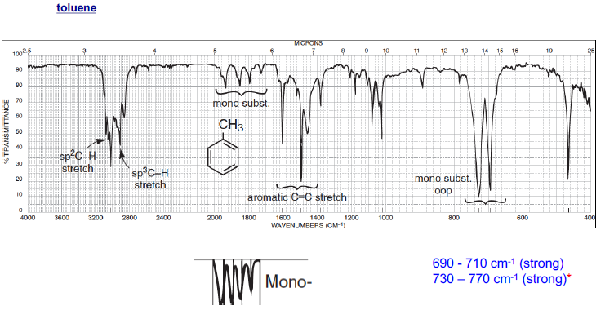

Slide 21
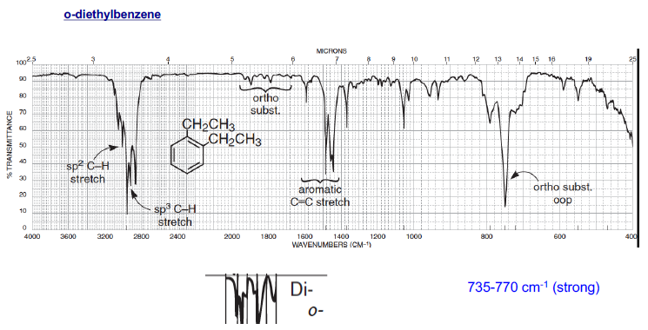

Slide 22
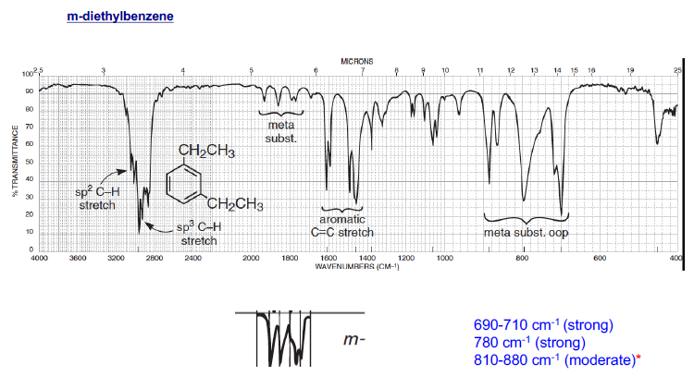

Slide 23
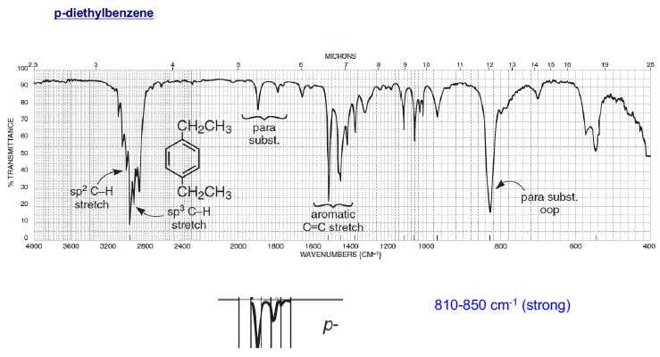

Slide 24
Alcohols & Phenols
• O-H stretch occurs between 3650-3300 cm⁻¹
- position and shape vary depending on amount of hydrogen bonding
• free O-H: sharp peak between 3650-3600 cm⁻¹
• H-bonded O-H: broad peak between 3500-3300 cm ⁻¹
• C-O-H bending vibrations between 1440-1220 cm ⁻¹
- not diagnostic
• C-O stretch between 1260-1000 cm ⁻¹
- can sometimes provide information about alcohol structure
  Band position changes depending on the alcohols substitution: 1°- 1075-1000; 2°-1075-1150; 3°- 1100-1200; phenol 1180-1260

Slide 26
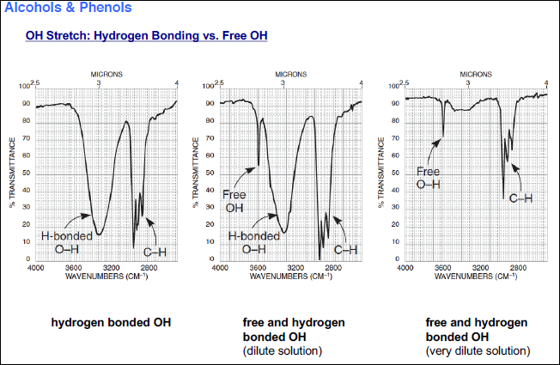

Slide 27
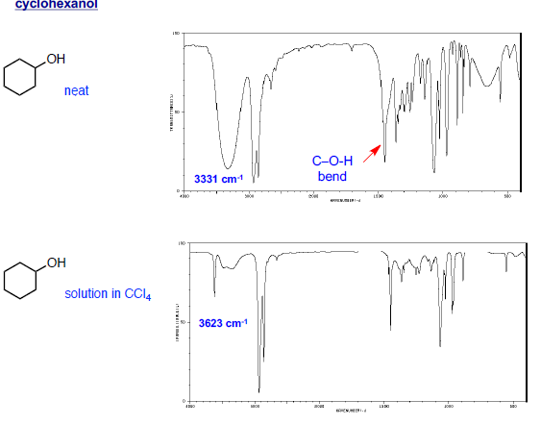

Slide 28
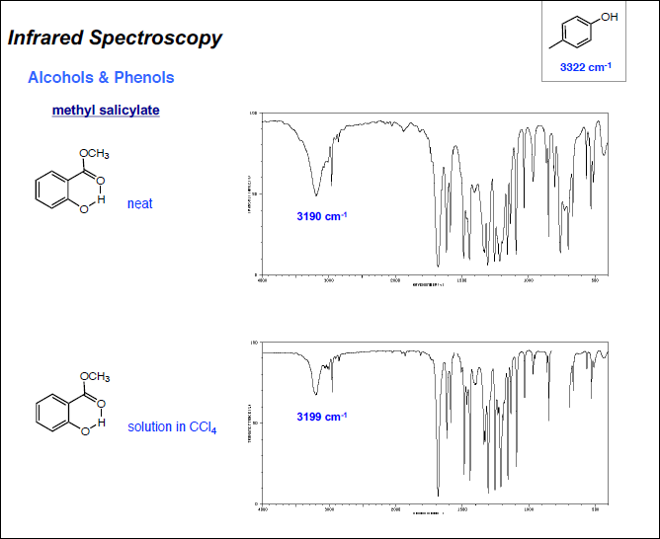

Slide 29
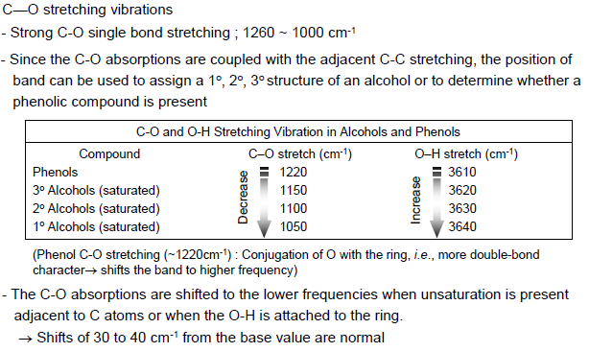


Slide 30
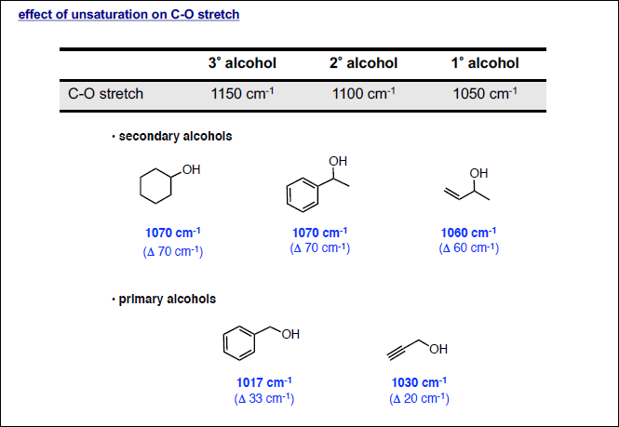
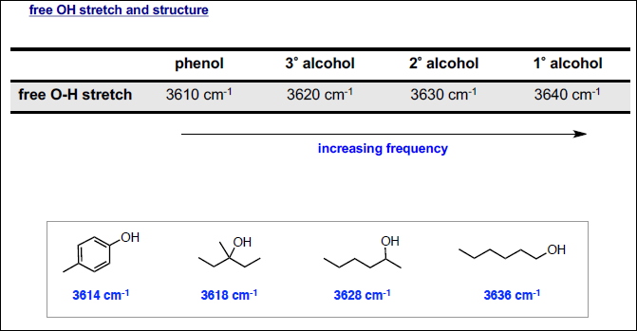

Slide 31
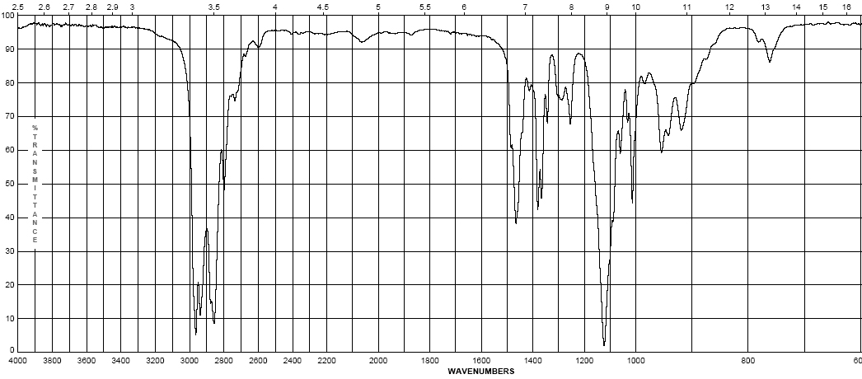
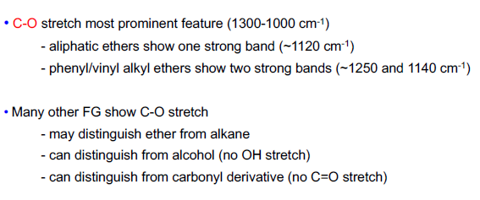
  Ethers – addition of the C-O-C asymmetric band and vinyl C-H bonds
    Show a strong band for the antisymmetric C-O-C stretch at 1050-1150 cm⁻¹
    Otherwise, dominated by the hydrocarbon component of the rest of the molecule
(s)
Diisopropyl ether

Slide 32
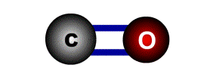
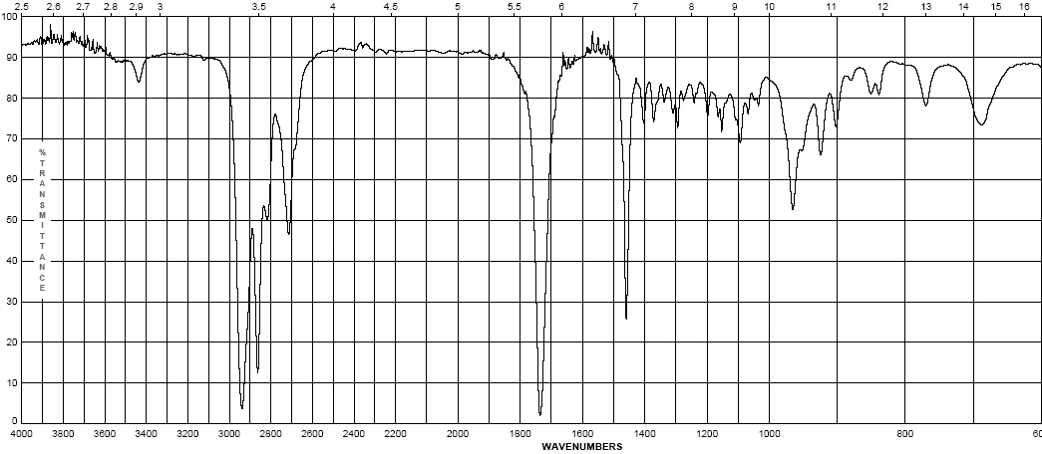
Cyclohexyl carboxaldehyde
  Aldehydes
    C=O (carbonyl) stretch from 1720-1740 cm⁻¹
    Band is sensitive to conjugation, as are all carbonyls (upcoming slide)
    A highly unique sp² C-H stretch appears as a doublet, 2720 & 2820 cm⁻¹ called a “Fermi doublet”
(w-m)
(s)

Slide 33
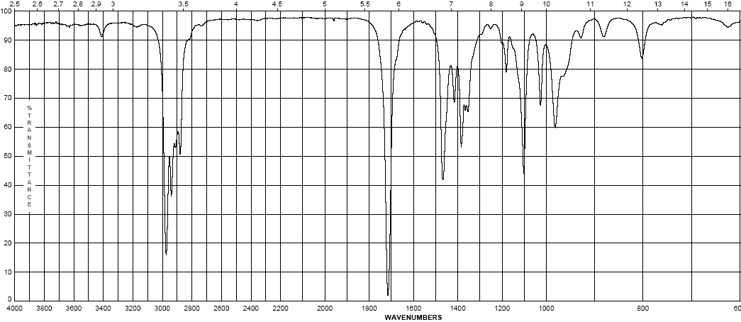
3-methyl-2-pentanone
  Ketones
    Simplest of the carbonyl compounds as far as IR spectrum – carbonyl only
    C=O stretch occurs at 1705-1725 cm⁻¹
(s)

Slide 34
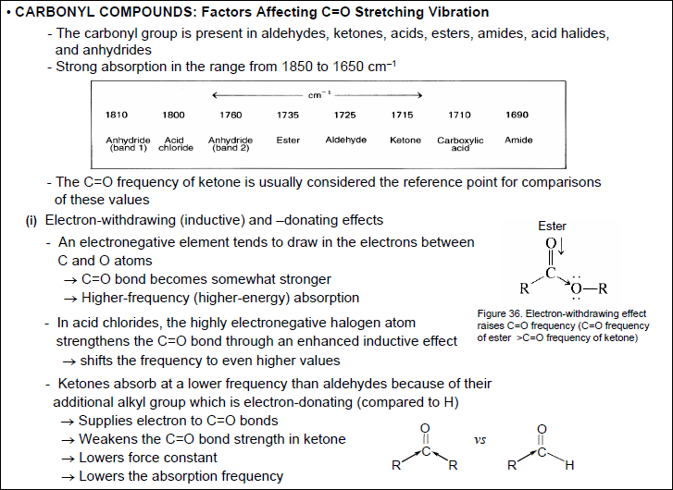

Slide 35
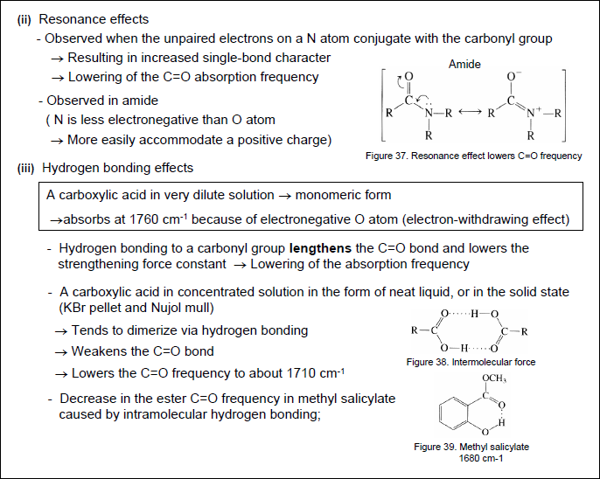

Slide 36
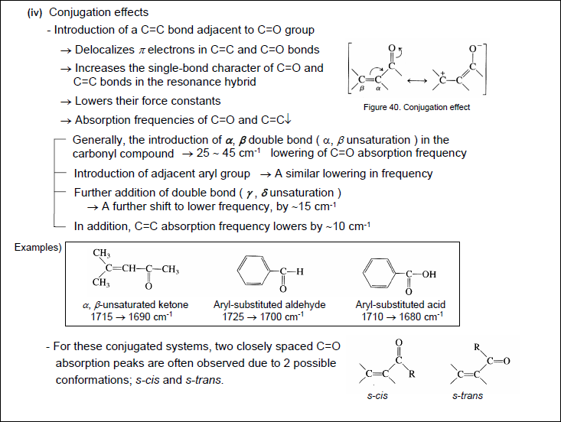

Slide 37
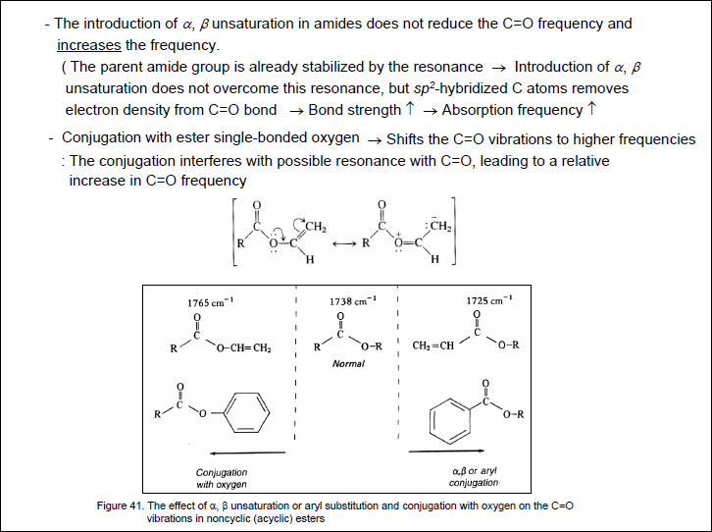

Slide 38
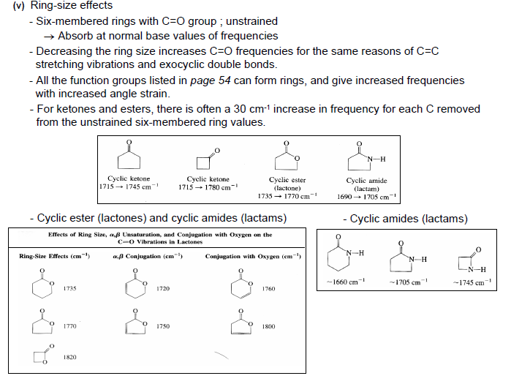

Slide 39
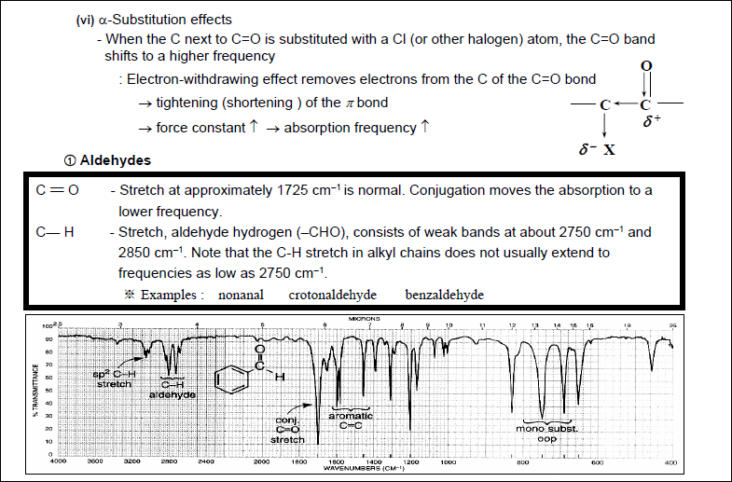

Slide 40
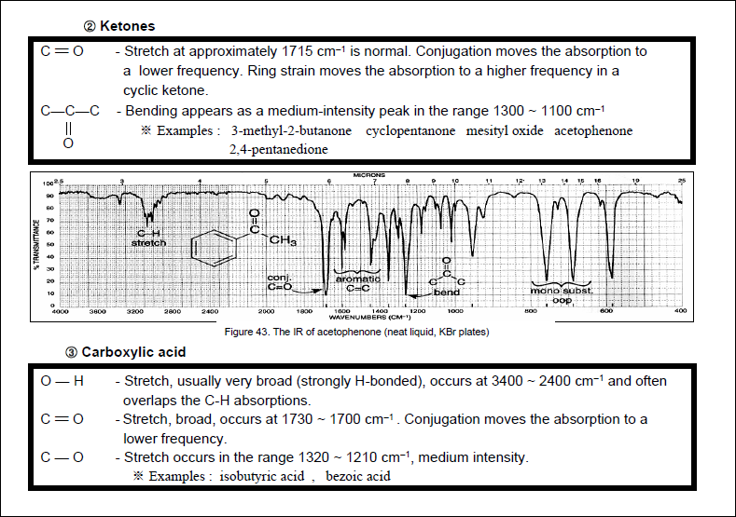

Slide 41
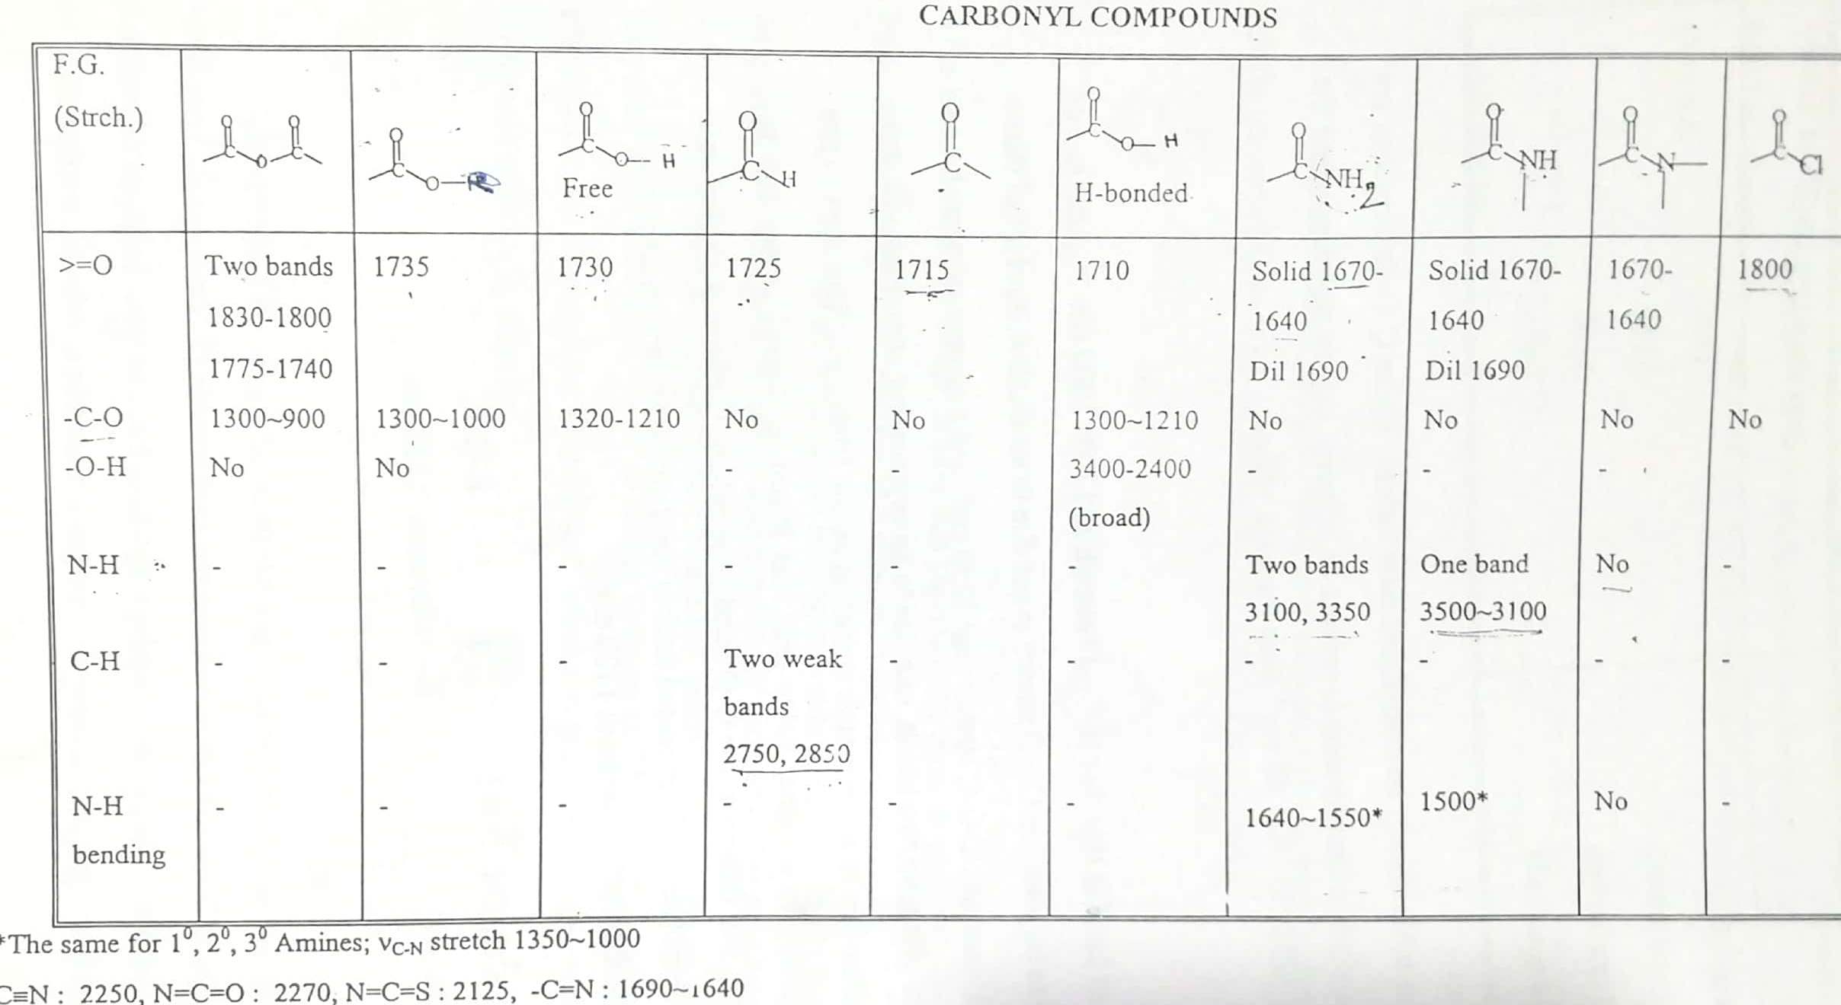

Slide 42
  Effects on IR bands
    Conjugation – by resonance, conjugation lowers the energy of a double or triple bond. The effect of this is readily observed in the IR spectrum:
      Conjugation will lower the observed IR band for a carbonyl from 20-40 cm⁻¹ provided conjugation gives a strong resonance contributor
      Inductive effects are usually small, unless coupled with a resonance contributor (note –CH₃ and –Cl above)

Slide 43
    Steric effects – usually not important in IR spectroscopy, unless they reduce the strength of a bond (usually π) by interfering with proper orbital overlap:
      Here the methyl group in the structure at the right causes the carbonyl group to be slightly out of plane, interfering with resonance
    Strain effects – changes in bond angle forced by the constraints of a ring will cause a slight change in hybridization, and therefore, bond strength
      As bond angle decreases, carbon becomes more electronegative, as well as less sp² hybridized (bond angle < 120°)

Slide 44
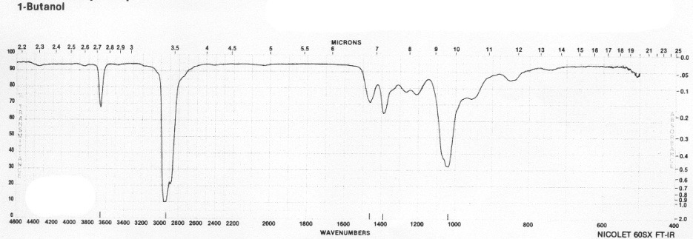
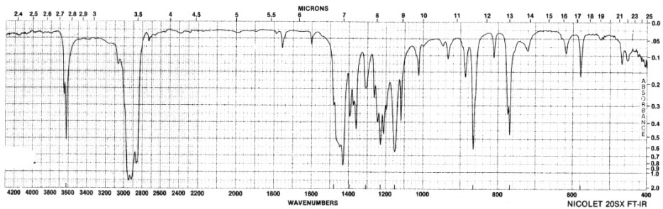
    Hydrogen bonding
      Hydrogen bonding causes a broadening in the band due to the creation of a continuum of bond energies associated with it
      In the solution phase these effects are readily apparent; in the gas phase where these effects disappear or in lieu of steric effects, the band appears as sharp as all other IR bands:
      Gas phase spectrum of
      1-butanol
      Steric hindrance to H-bonding
      in a di-tert-butylphenol
      H-bonding can interact with other functional groups to lower frequencies

